Slide 1


HEALTH CONNECT: WEB-BASED HEALTH MONITORING SERVICES FOR BARANGAY HEALTH CENTER OF BARANGAY POBLACION PRES. QUIRINO, S.K
RESEARCH PRESENTER
SHALIMAR P BAGUAN
MOHIDIN B. MABANG
ALLADIN G. ANTOLIN
NICKO K. NAVARRO
RASID S UNTUA

Slide 2
BACKGROUND OF THE STUDY
The healthcare service delivery in Barangay Poblacion, President Quirino, Sultan Kudarat, remains heavily dependent on manual, paper-based systems. Patient records are documented by hand, appointments are scheduled informally. This manual approach has led to recurring inefficiencies such as lost or inaccurate records, missed appointments, and delays in patient care. Health workers face difficulties retrieving accurate medical histories, often resulting in prolonged waiting times and miscommunication with patients. Several studies highlight the role of mobile-based health information systems in addressing these challenges. Marquez et al. (2022) emphasized that mobile health platforms enhance record-keeping, appointment scheduling, and inventory management while improving patient–provider communication. Likewise, Dela Cruz and Bautista (2021) reported that mobile applications with immunization tracking, automated reminders, and real-time reporting significantly improve timely healthcare delivery in rural areas.

Slide 3
This study aims to develop the Health Connect: Web-based health monitoring services for Barangay Health Center in response to these findings and the urgent requirements of Barangay Poblacion. Centralized patient record management, with SMS alerts and a data analytics dashboard are all features of the system. The application will include offline caching features, user training courses, and strong encryption mechanisms to address potential issues including low digital literacy, erratic internet access, and data security worries. In the end, Health Connect seeks to increase patient participation, guarantee correct and easily accessible health data, boost service efficiency, and fortify the barangay health center's general responsiveness.

Slide 4
GENERAL OBJECTIVES
This study generally aims to develop and evaluate the “Health Connect: Smart Mobile Application for Barangay Health Center of Barangay Poblacion, Pres. Quirino, S.K.
SPECIFIC OBJECTIVES
This study specifically aims to:
1. Develop a Web-based Health Monitoring Service that can manage barangay health worker’s account information.
2. Allow Nurse and Midwife to manage patient records, including personal details, medical history, and treatment information
3. Enable patients to schedule appointments and receive automated SMS notifications for appointment reminders
4. Develop a system for tracking and managing immunization schedules for both children and adults in the community.

Slide 5
5. Provide a data dashboard with graphical presentation to track;
5.1. Total number of appointments Day/ Week/ Month
5.2. Number of patients Day/ Week/ Month
6. Generate reports such as;
6.1. List of appointments
6.2. List of patients
6.3. Patient’s medical record
6.4. Appointment Slip

Slide 6
SIGNIFICANCE OF THE STUDY
The Barangay Health Center
Implementing Health Connect streamlines operations by replacing paper logs with a unified dashboard that tracks appointments and patient flow, enabling smarter resource allocation and early bottleneck detection. Automated reminders reduce no-shows, while upfront challenges like setup costs and connectivity can be managed with contingency planning to ensure lasting efficiency.
The Barangay Health Workers
Health Connect reduces admin tasks for health workers by digitizing patient records and immunization tracking, freeing time for care. Features like improve follow-up, but successful adoption needs training, support, and a rollout plan with guides and peer mentoring to build confidence.
The Patients
Patients benefit from easier scheduling, reminders. To ensure inclusivity, fallback options like SMS and phone calls, plus user education, are key for those with limited digital access.

Slide 7
The Researcher
Studying Health Connect in barangays offers insights into mobile health adoption, highlighting usability, impact, and challenges in low-resource settings. Evaluating features, access, and training helps refine future rollouts, with findings guiding other communities through case studies and practical lessons.
The Community and Policymaker
A successful Health Connect model in Barangay Poblacion Pres. Quirino can guide policy on digital health investments, showing improved care and resource use. It offers leaders a blueprint for tech-driven primary care, while raising key issues like digital access, data privacy, and long-term sustainability.
The IT Developers and System Maintainers
Studying Health Connect in barangays offers insights into mobile health adoption, highlighting usability, impact, and challenges in low-resource settings. Evaluating features, access, and training helps refine future rollouts, with findings guiding other communities through case studies and practical lessons.
The Educators and Students
Health Connect offers IT and public health students a real-world example of interdisciplinary collaboration, covering design, deployment, and evaluation of community digital solutions. It enriches learning with practical insights into ethics, accessibility, and sustainability beyond textbooks.

Slide 8
SCOPE AND LIMITATION OF THE STUDY
This study will be focus on the design, development, implementation, and evaluation of a Web-based health monitoring services platform called Health Connect, specifically created for the Barangay Health Center of Barangay Poblacion, Pres. Quirino, Sultan Kudarat. The system aims to improve healthcare service delivery through a centralized mobile application tailored to the needs of barangay health workers and local residents. The scope includes the creation of a module for managing health worker accounts, as well as a comprehensive patient record system that stores personal details, and treatment information. It allows patients to schedule appointments through the app and receive automated SMS notifications for reminders.

Slide 9
Additionally, the application provides a user-friendly dashboard displaying graphical summaries of key data such as the total number of appointments, patient count, and daily appointment records. Report generation features are included to produce lists of appointments and patients, patient medical records, and appointment slips. The study also involves evaluating the system's performance in terms of accuracy, security, functionality, and effectiveness. Evaluation will be conducted through a pilot deployment at the Barangay Health Center, with testing focused on the usability of the app in local contexts, including areas with low internet connectivity. The web-based is developed for website considering the accessibility needs of users with limited technical knowledge and devices.

Slide 10
Despite its wide the scope is limited to the implementation and evaluation of the system within Barangay Poblacion, Pres. Quirino. Integration with municipal or national health information systems is not covered. Dashboard analytics are limited to basic counts and visualizations, without advanced data mining or predictive modeling. While the app offers offline caching for select features, full offline functionality with automatic data synchronization is beyond the scope. The platform is designed for web application.

Slide 11
METHODOLOGY
HARDWARE REQUIREMENTS
QTY. | COMPONENTS | SPECIFICATION
1 | PC | (8Gb RAM, Intel Core i7, 1 TB (HDD))
1 | PRINTER | Brother
 | Other Peripherals | Keyboard, mouse, mouse pad, flash drive
1 | WI-FI | PLDT
Table 1 shows the tabular representation in the hardware requirements that was used in developing the system, the researchers provided 1 laptop with the brand and specifications such as PC (8Gb RAM, Intel Core i7, 1 TB (HDD)), 1 printer, (Brother) and 1 Wireless Fidelity, (PLDT Wi-Fi).

Slide 12
METHODOLOGY
SOFTWARE REQUIREMENTS
Database Application | Xampp (phpMyAdmin, MySQL)
Web Scripting Languages | PHP, HTML, CSS, JavaScript
Front-end Framework/Web Framework | Bootstrap
Web Designing Tools | HTML, CSS, Ajax
Operating System | Windows 10 and 11
Office Application | WPS (Word, and Powerpoint)
Table 2 shows the tabular representation of the software requirements used in the system. The researchers used the following software applications and tools in the development of the system: Web Scripting Languages (PHP, HTML, CSS, JavaScript), Front-end Framework/Web Framework (BOOTSTRAP), Web Designing Tools (HTML, CSS, Ajax), Operating System (Windows 10 and 11), and Office Application WPS (Word and PowerPoint).

Slide 13
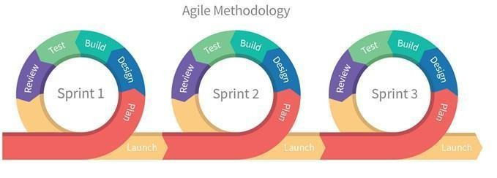
METHODS USED IN DEVELOPING A SYSTEM
Agile Software Development Methodology was developed to ensure satisfaction of the requirements among existing computerized system. It is a methodology construction to make sure that the requirements planning, development and implementation, testing of the system follows logical approach and technical ways

Slide 14
Figure 2. Agile Methodology Model
Sets of related activities are organized inside of Agile Model.
1. Plan
2. Design
3. Build
4. Test
5. Review
6. Launch

Slide 15

1
CONTEXT DIAGRAM (EXISTING SYSTEM)

Slide 16
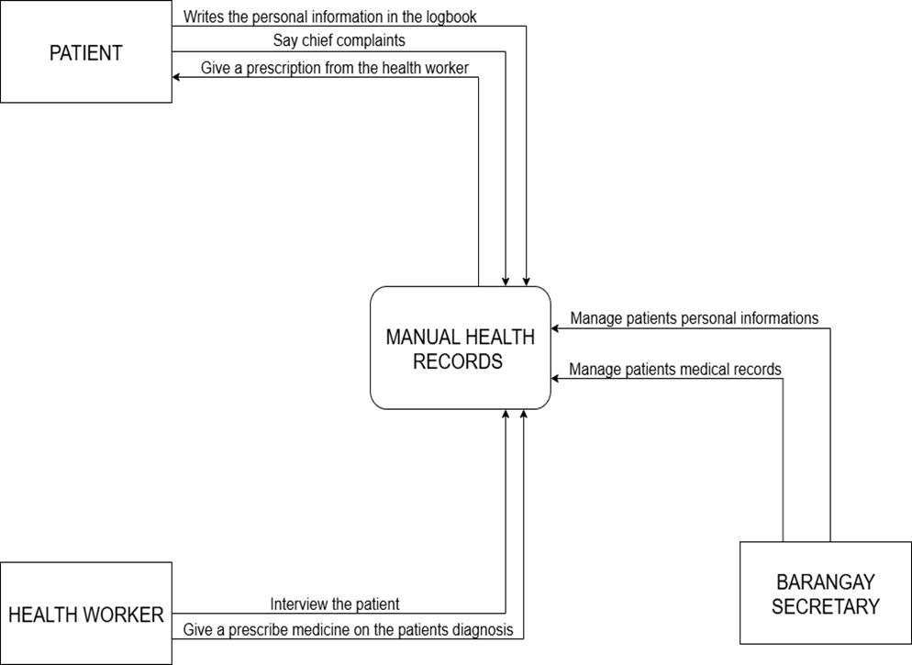
CONTEXT DIAGRAM OF THE EXISTING SYSTEM

Slide 17
Figure 3. The Context Diagram of the Existing System
Figure 3. The Context Diagram of the Existing System Figure 3 showed the diagram of the existing system illustrates the high-level interactions between external entities and the central "Manual Health Records" process. This diagram depicts three primary external entities: "Patients", "Health Workers" and “Barangay Secretary”. Patients interact with the system by providing their "chief complaints" and receiving a "prescription from the health worker" and “Barangay Secretary” manages the patient personal information and medical records. They also have their "personal information written in the logbook," which is then integrated into the "Manual Health Records." On the other hand, Health Workers "interview the patient" and "give a prescribed medicine on the patients diagnosis," with these activities directly influencing and being influenced by the "Manual Health Records." The diagram highlights the manual nature of the current system, where all information flows through and is managed within the "Manual Health Records" entity.

Slide 18
2
DATA FLOW DIAGRAM (EXISTING SYSTEM)

Slide 19
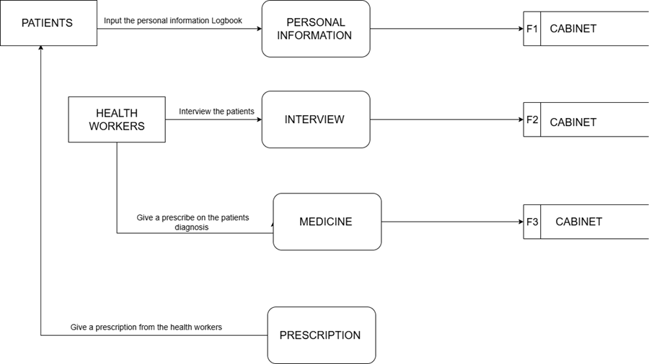
DATA FLOW DIAGRAM OF THE EXISTING SYSTEM

Slide 20
Figure 4. Data Flow Diagram (Existing System)
Figure 4 shows the manual operations and information flow of the existing system. The existing system for managing patient information is a largely manual and physical process, involving interactions between Patients and Health Worker. Patients initiate the process by providing their personal details, which are then recorded and stored in a physical "F1 Cabinet." Concurrently, Health Workers conduct interviews with patients, and the resulting interview information is documented and stored in a "F2 Cabinet." Following the interview, Health Workers prescribe medicine based on diagnoses, with the details of the prescribed medication being recorded and filed in a "F3 Cabinet." Finally, Health Workers issue prescriptions to patients, marking the culmination of the patient's interaction with the system. This setup indicates a traditional, paper-based approach to record-keeping, relying on physical storage for all critical patient data.

Slide 21
3
CONTEXT DIAGRAM (PROPOSED SYSTEM)

Slide 22
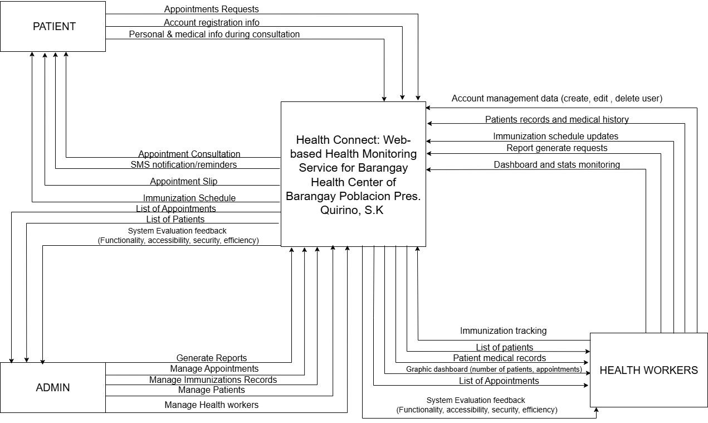
CONTEXT DIAGRAM OF THE PROPOSED SYSTEM

Slide 23
Figure 5. The Context Diagram of the Study
Figure 5 illustrates the core functions and interactions between the main users’ admin , patients , health workers and the system. It emphasizes how the mobile application serves as a centralized platform for managing health worker accounts, handling patient records, and monitoring immunization schedules. Patients can register accounts, submit appointment requests, and receive SMS notifications and appointment slips. Health workers, on the other hand, can manage patient medical records, update immunization schedules, and monitor system statistics through a dashboard that visualizes patient and appointment data. Admin on the other hand manage health workers , patients accounts , monitor system statistics through a dashboard that visualizes patient and health worker data. The system also supports automated report generation, allowing health workers to generate lists of patients, and appointments. Additionally, the system is designed to be evaluated based on functionality, security, accessibility, and efficiency. This context diagram highlights the automated and integrated nature of the system, reducing manual processes and improving communication between patients and health professionals.

Slide 24
4
DATA FLOW DIAGRAM (LOGICAL)

Slide 25
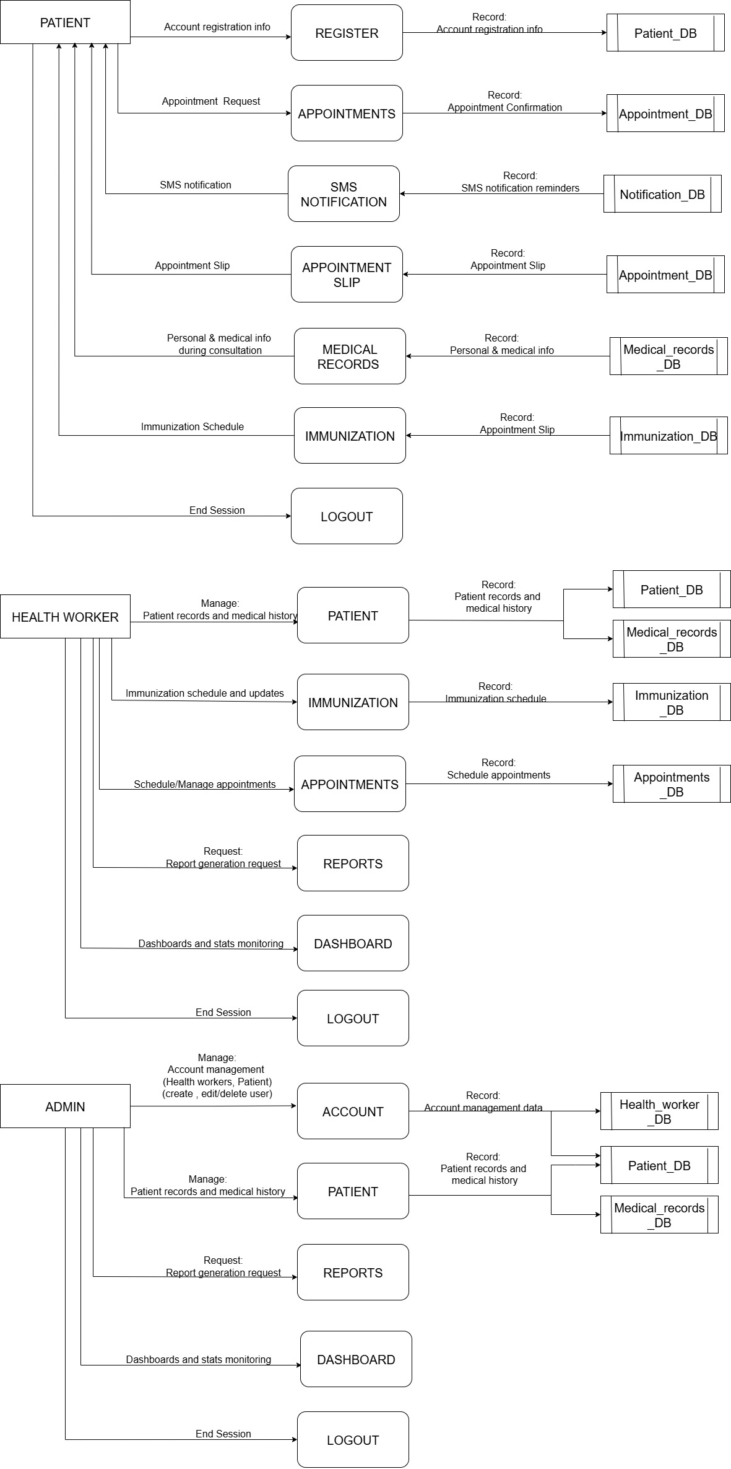
LOGICAL DATA FLOW DIAGRAM OF THE PROPOSED SYSTEM

Slide 28
Figure 6. The Logical Data Flow Diagram of the System
Figure 6 shows the healthcare management system designed around two primary user roles: Patients , Health Workers and Admin. Patients initiate interactions by registering accounts storing their information in the Patient_DB and requesting appointments, which are logged in the Appointment_DB. During consultations, they provide personal and medical details that are recorded in the Medical_record_DB. Patients can also submit feedback and chat messages, and receive SMS notifications such as appointment confirmations managed through the Notification_DB. Additionally, they access immunization schedules from the Immunization_DB, view their medical records, and generate appointment slips for upcoming visits.
Health Workers, on the other hand, manage a broader range of system workflows. They oversee appointments, review and update patient profiles in the Patient_DB, and maintain detailed medical histories in the Medical_record_DB.

Slide 29
Admin , on the other hand, manage health workers account and patients account , personal information and medical records in the Health_worker_DB, Patient_DB and Medical_records_DB, request a report generation and monitor dashboard and statistics (health worker , patients' data) .
The system emphasizes smooth data synchronization across eight core databases: Patient_DB (registration), Medical_record_DB (health history), Appointment_DB (bookings), Immunization_DB (vaccine scheduling), Notification_DB (SMS alerts), and Health_worker_DB (staff credentials). Key processes include appointment coordination (linking patient requests to health worker schedules), medical data consolidation (updating records during consultations), and automated notifications (sending SMS confirmations). As a logical DFD, this model abstracts away technical implementation details such as infrastructure or security and focuses instead on the flow of data, user interactions, and storage mechanisms to represent a streamlined, patient-centric healthcare workflow.

Slide 30
5
DATA FLOW DIAGRAM (PHYSICAL)

Slide 31
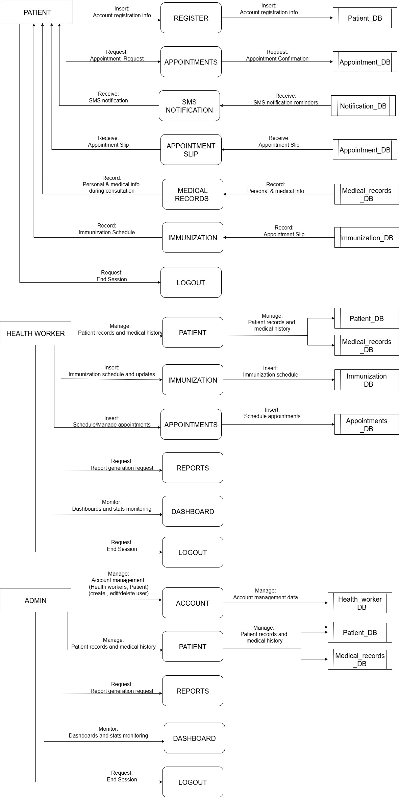
PHYSICAL DATA FLOW DIAGRAM OF THE PROPOSED SYSTEM

Slide 34
Figure 7. The Physical Data Flow Diagram of the System
Figure 7 presents an implementation-specific view of a healthcare management system, building upon the logical model by incorporating concrete components, technologies, and workflows. It restrains the triple-user structure of Patients, Health Workers and Admin, but adds physical elements such as SMS notifications, graphical dashboards, and explicit interactions with system databases. For Patients, the workflow begins with appointment booking and registration through the Appointment module. During registration, personal details are stored in the Patient_DB, while confirmed bookings result in the creation of an Appointment Slip stored in the Appointment_DB and trigger automated SMS alerts via the Notification_DB. Patients can access their historical health data from the Medical_record_DB and review vaccination schedules stored in the Immunization_DB. Patient sessions conclude with a logout process. Admin , on the other hand, manage health workers account and patients account , personal information and medical records in the Health_worker_DB, Patient_DB and Medical_records_DB, request a report generation and monitor dashboard and statistics (health worker , patients' data) .

Slide 35
Health Workers manage a range of operational tasks. They handle appointments via the Appointment_DB, access demographic data from the Patient_DB, and consult or update medical histories in the Medical_record_DB during consultations. Vaccine administration and monitoring are handled through the Immunization_DB. Analytical functions are supported through Graphical Dashboards, which visualize data trends such as appointment volumes and medicine inventory levels. A System Evaluation module helps monitor system performance. Reports are generated as needed, and sessions end with a logout.
Several key physical components enhance system functionality. The SMS Notification System, integrated with the Notification_DB, automates appointment alerts. Real-time Graphical Dashboards render analytics such as immunization coverage and resource utilization. All core data is stored in centralized databases, including Patient_DB (registration), Appointment_DB (bookings), Medical_record_DB (health records), Immunization_DB (vaccines), and Health_worker_DB (staff credentials).

Slide 36
The Implementation-Specific Workflow for patients typically follows the sequence: Registration → Appointment → SMS Alert → Consultation → Medical Record Access → Logout.
For admin, on the other hand: Manage Accounts (health workers , patients) → Patient Profile Check → Medical Record Update→ Dashboard Analytics→ Logout.
For health workers, it proceeds as: Appointment Review → Patient Profile Check → Medical Record Update→ Dashboard Analytics → Logout.
This physical DFD distinguishes itself from the logical model by introducing physical artifacts like the SMS gateway (Notification_DB), appointment slip generation, and interactive dashboards. Ultimately, the purpose of this physical DFD is to illustrate how the system operates in a practical environment. Patients benefit from digital appointment slips and SMS alerts, while health workers leverage dashboards for data-driven decisions and integrate inventory management with medical processes. The databases represent physical data structures such as tables or collections and support consistent, secure, and user-friendly workflows. As a comprehensive technical blueprint, this DFD guides developers in deploying a fully functional, patient-centric healthcare system.

Slide 37
Ultimately, the purpose of this physical DFD is to illustrate how the system operates in a practical environment. Patients benefit from digital appointment slips and SMS alerts, while health workers leverage dashboards for data-driven decisions and integrate inventory management with medical processes. The databases represent physical data structures such as tables or collections and support consistent, secure, and user-friendly workflows. As a comprehensive technical blueprint, this DFD guides developers in deploying a fully functional, patient-centric healthcare system.

Slide 38
6
ENTITY-RELATIONSHIPDIAGRAM (ERD

Slide 39
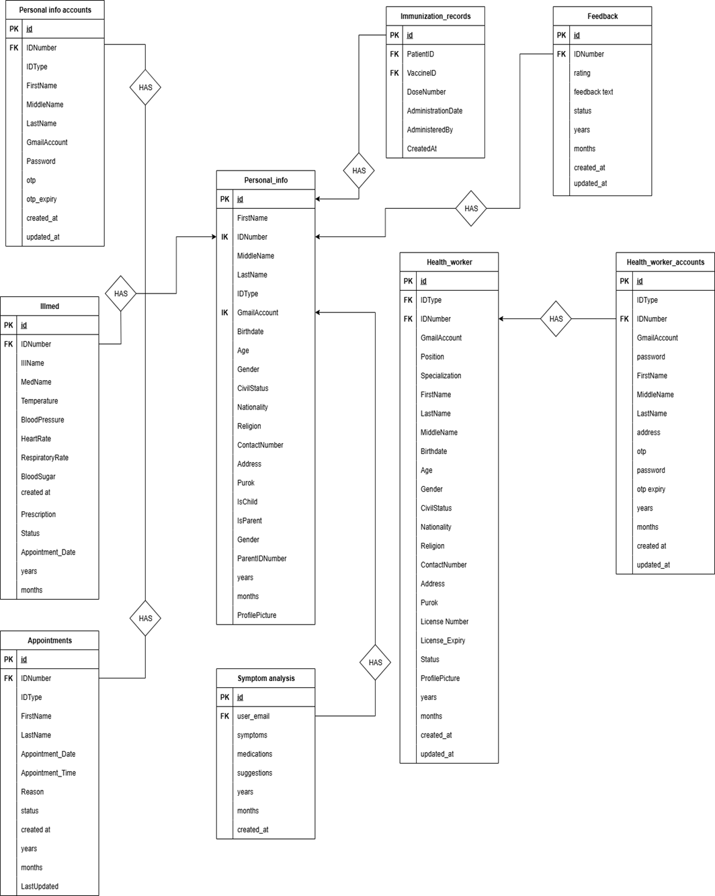
ENTITY-RELATIONSHIP DIAGRAM OF THE STUDY

Slide 41
Figure 8. Entity-Relationship Diagram of the Study
Figure 8 shows the data structure and relationship between entities in the System. It will demonstrate the data about personal accounts, personal information, medical records (illness, immunization, symptom analysis), health workers, and vaccine dispensing are organized and connected within the system. The ERD emphasized primary keys (PK) and foreign keys (FK) to establish relationships, ensuring data consistency and integrity throughout the system. The relationships included:
·One Personal_info_accounts HAS one Personal_info.
·One Personal_info HAS many Illmed entries.
·One Personal_info HAS many Immunization_records.
·One Personal_info HAS many Feedback entries.
·One Personal_info HAS many Symptom_analysis entries.
·One Personal_info HAS many Appointments.
·One Personal_info HAS many Health_worker entries.
·One Vaccines HAS many Immunization_records.
·One Vaccines HAS many Vaccine_dispensing entries.
·One Health_worker_accounts HAS one Health_worker.

Slide 42
7
RESEARCH DESIGN & RESPONDENTS OF THE STUDY

Slide 43
RESEARCH DESIGN
This study adopts a Design and Development Research (DDR) approach, integrating descriptive, developmental, and evaluative research methods. The goal is to design, develop, and assess a Smart Mobile Application for Brgy. Health Center of Brgy. Poblacion, Pres. Quirino, S.K by addressing manual limitations in patient management, medicine tracking, and communication.
RESPONDENTS OF THE STUDY
The participants of this study are selected from key stakeholders directly involved in the use, management, and evaluation of the Heath Connect system. These include barangay health workers, health center administrators, patients or their guardians, IT support personnel, and the researchers themselves.

Slide 44
8
PROTOTYPE

Slide 45
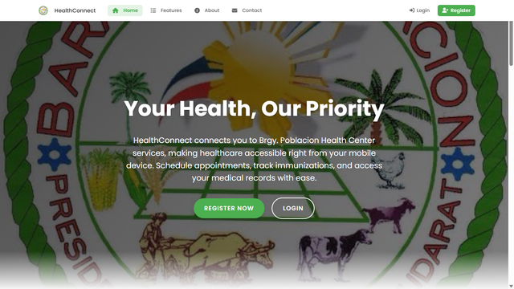
LANDING PAGE;

Slide 46
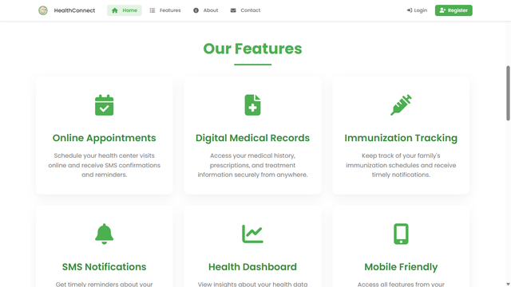
LANDING PAGE;

Slide 47
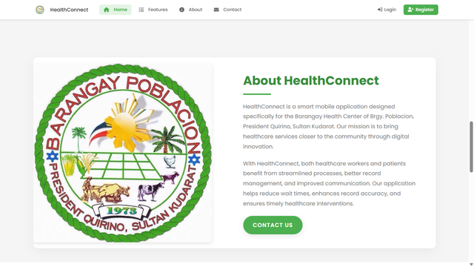
LANDING PAGE;

Slide 48
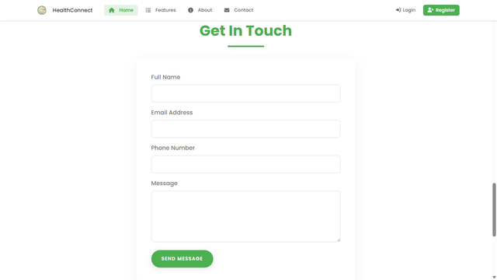
LANDING PAGE;

Slide 49
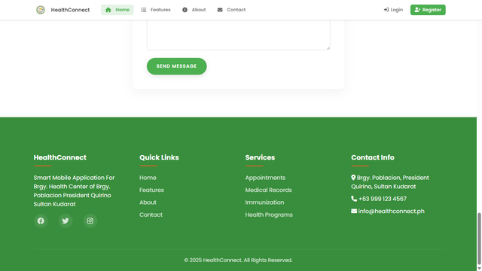
LANDING PAGE;

Slide 50
9
LOGIN PAGE

Slide 51
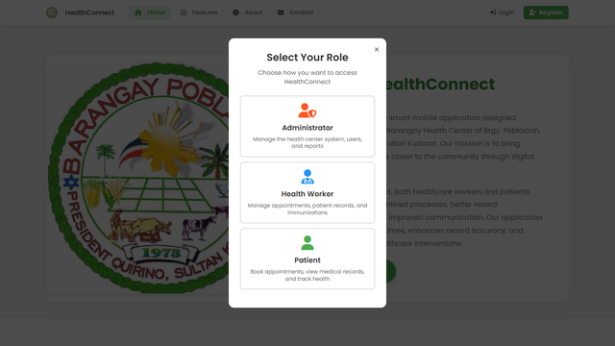
LOGIN PAGE;

Slide 52
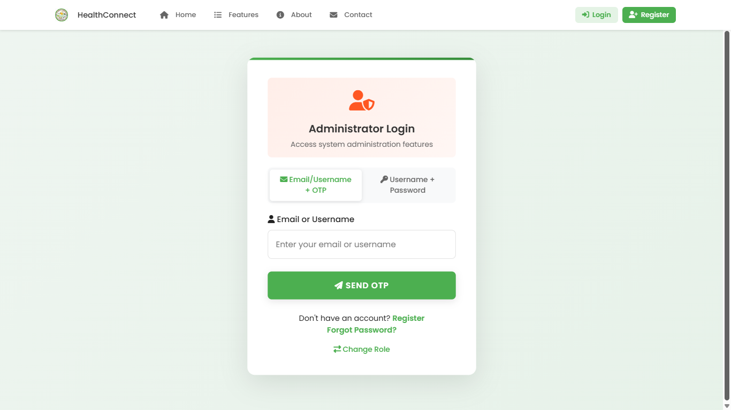
LOGIN PAGE;

Slide 53
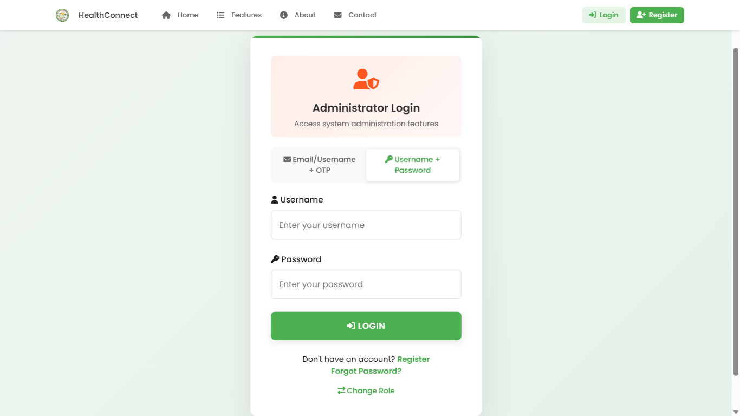
LOGIN PAGE;

Slide 54
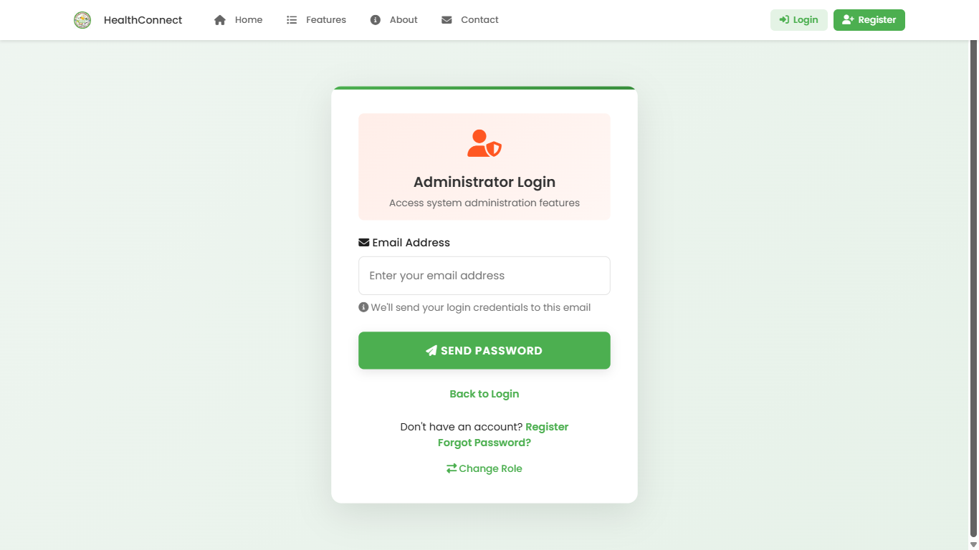
LOGIN PAGE;

Slide 55
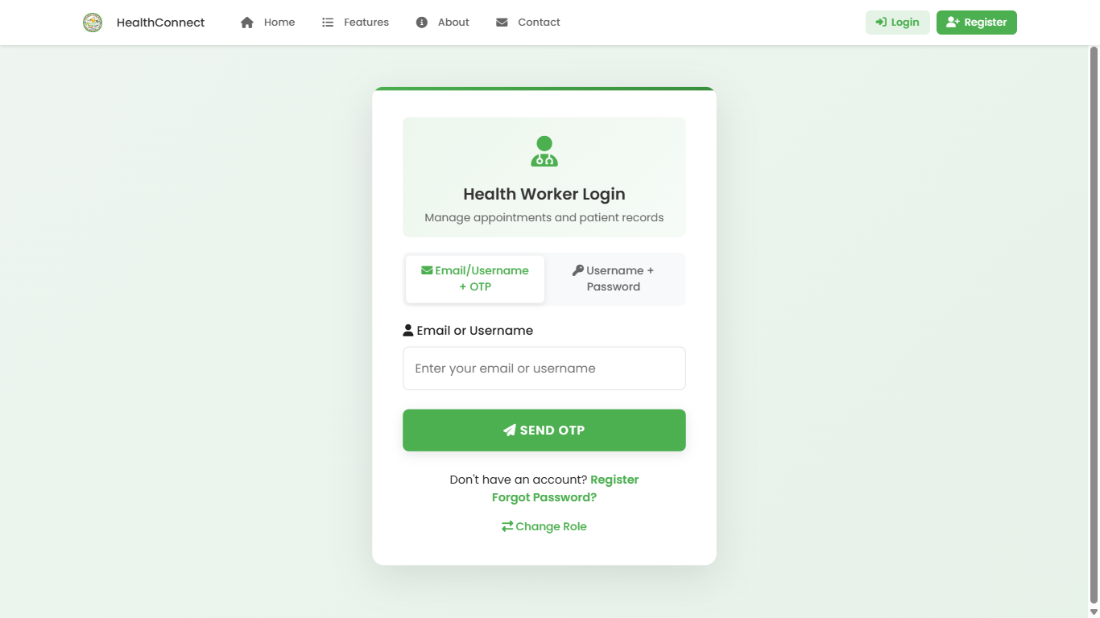
LOGIN PAGE;

Slide 56
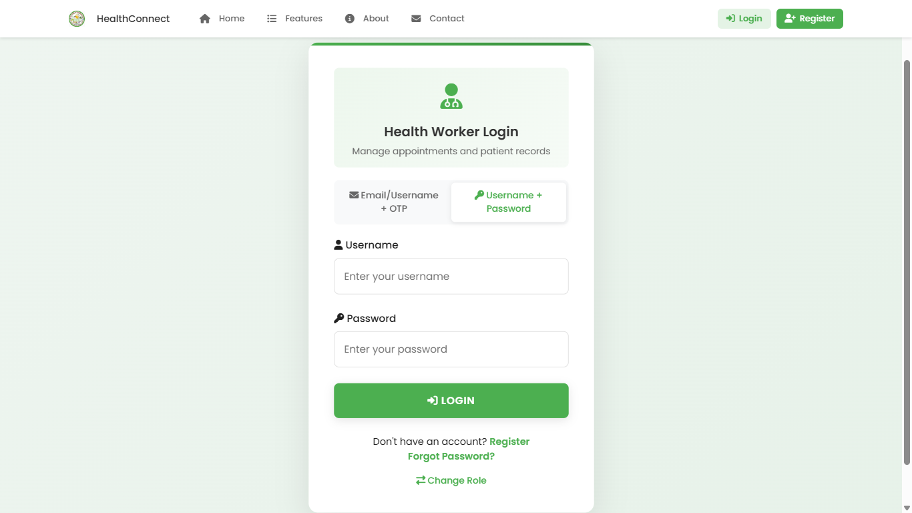
LOGIN PAGE;

Slide 57
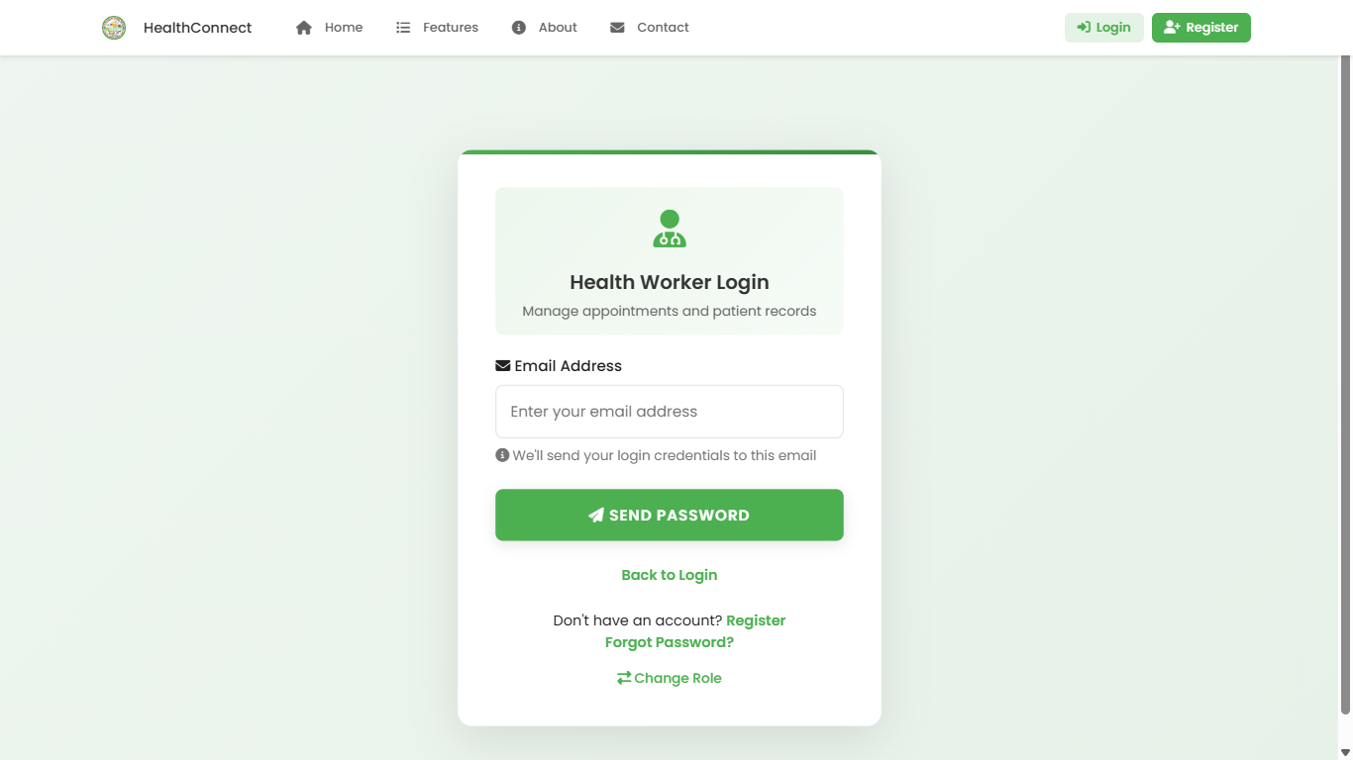
LOGIN PAGE;

Slide 58
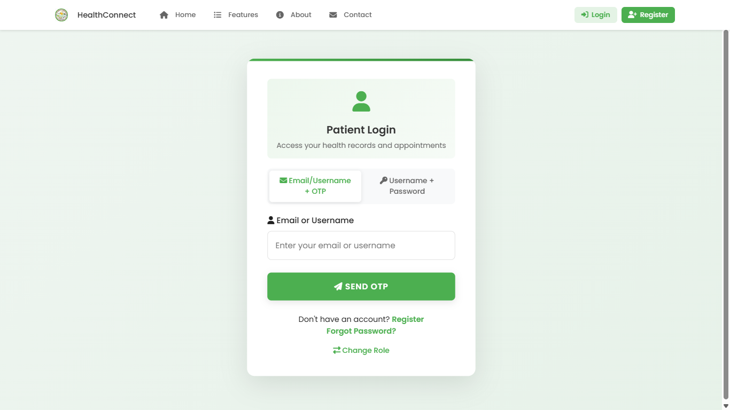
LOGIN PAGE;

Slide 59
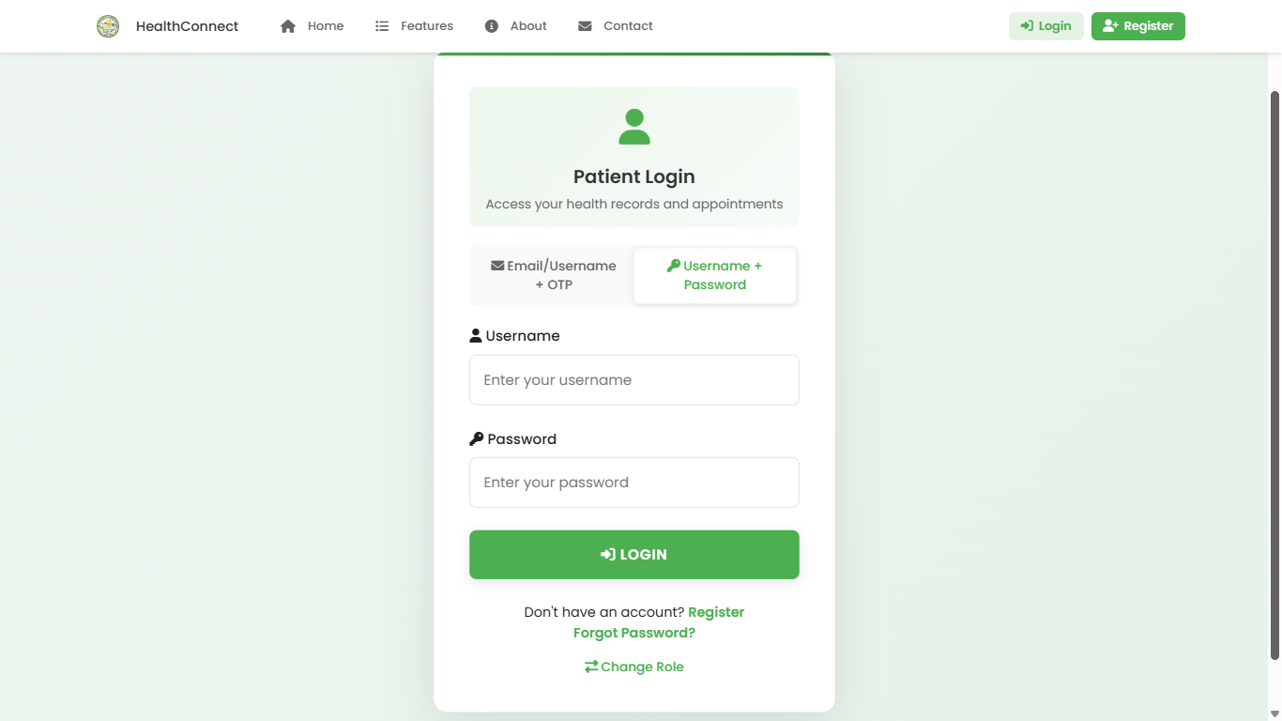
LOGIN PAGE;

Slide 60
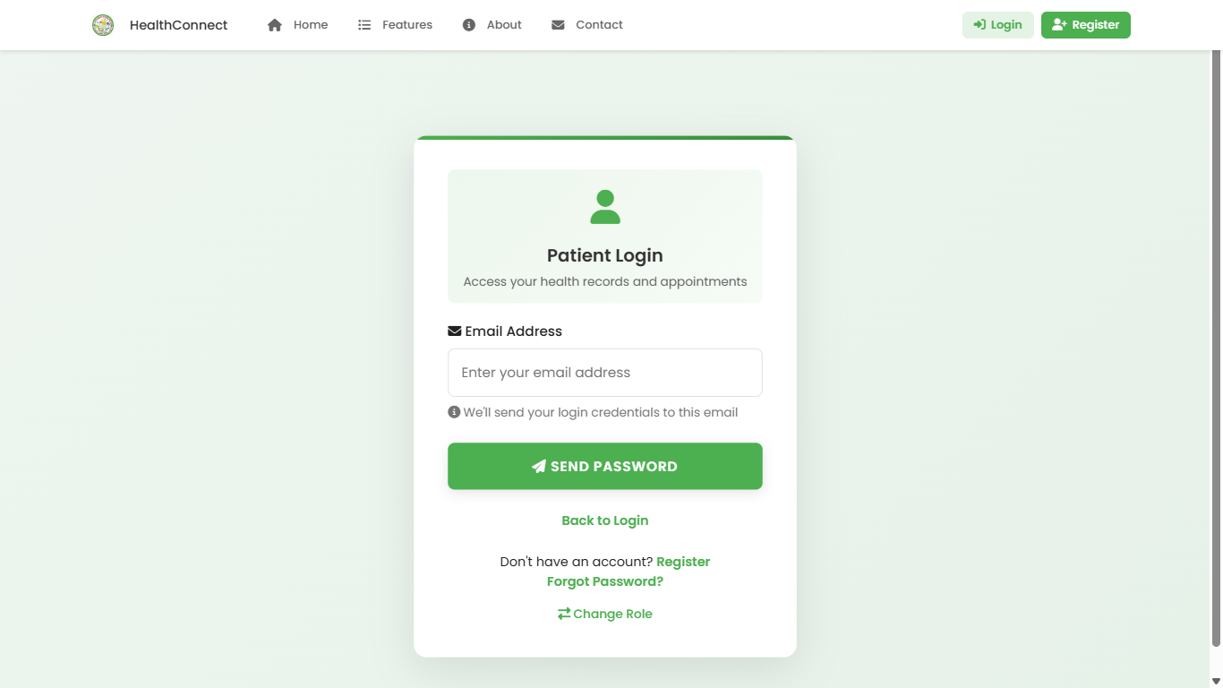
LOGIN PAGE;

Slide 61
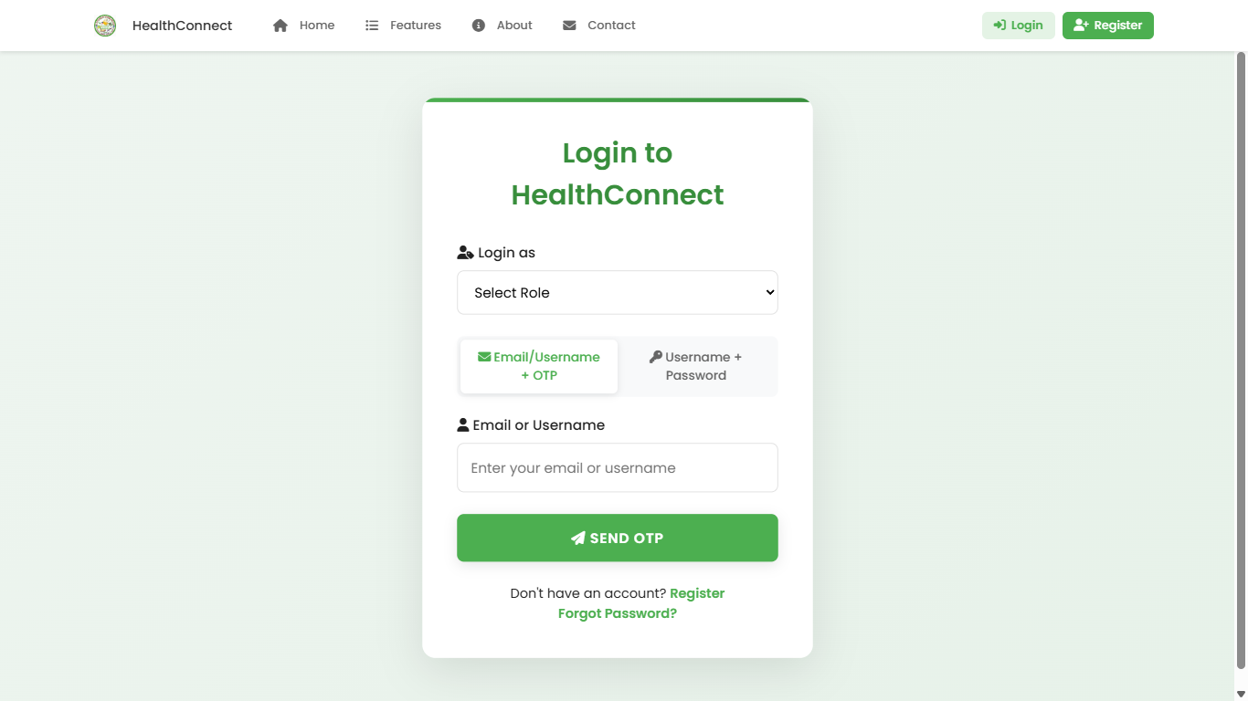
LOGIN PAGE;

Slide 62
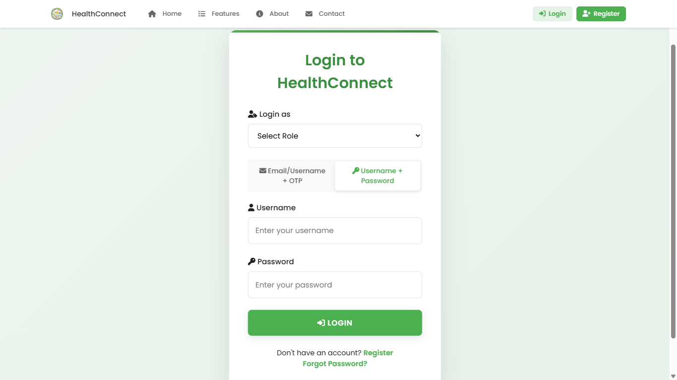
LOGIN PAGE;

Slide 63
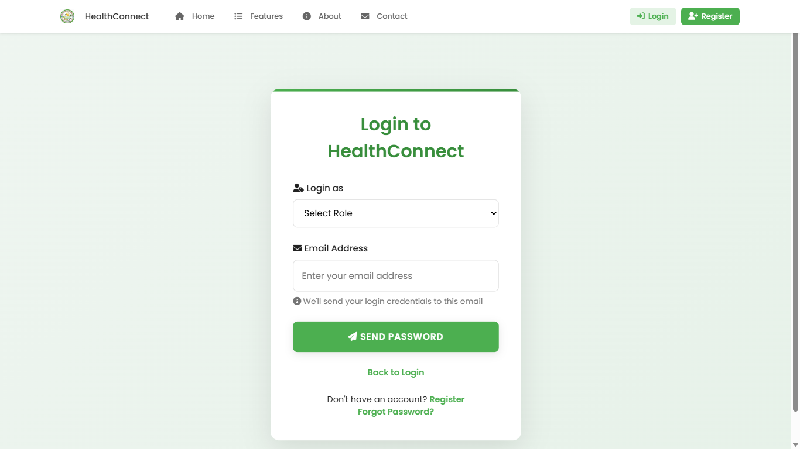
LOGIN PAGE;

Slide 64
10
REGISTER

Slide 65
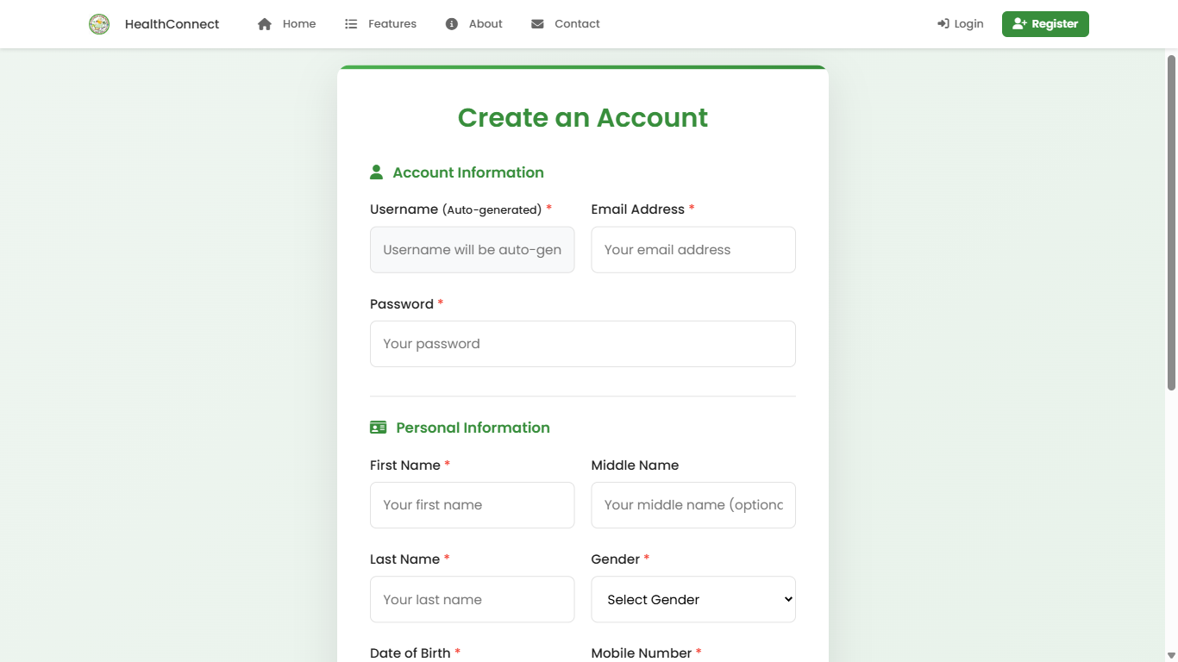
REGISTER PAGE;

Slide 66
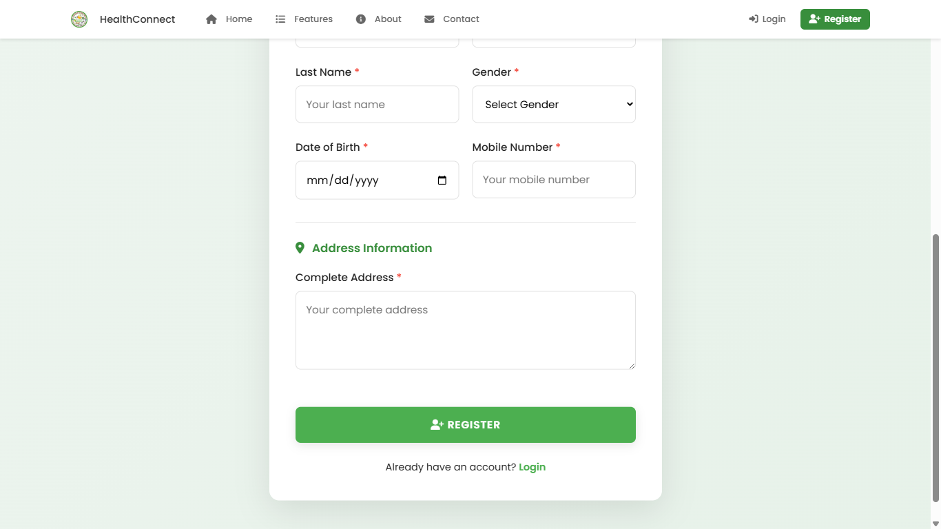
REGISTER PAGE;

Slide 67
11
ADMIN PAGE

Slide 68
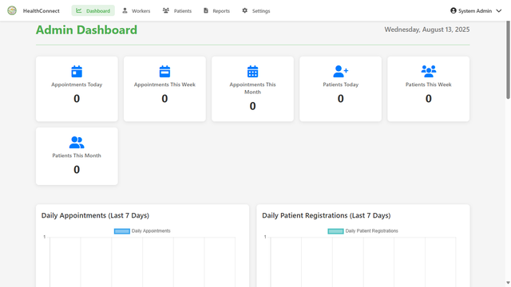
ADMIN PAGE;

Slide 69
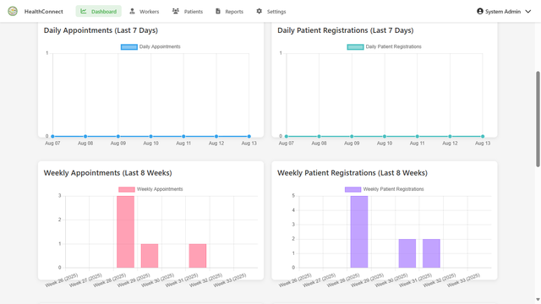
ADMIN PAGE;

Slide 70
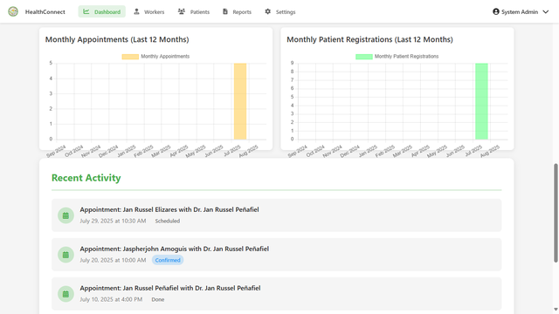
ADMIN PAGE;

Slide 71
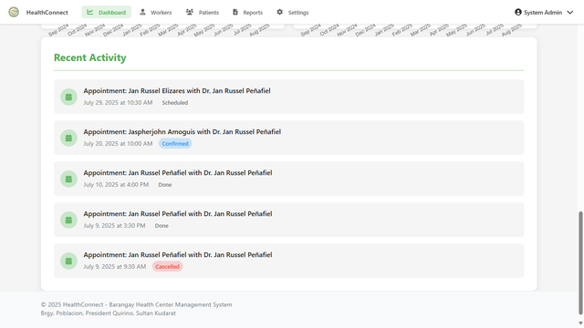
ADMIN PAGE;

Slide 72
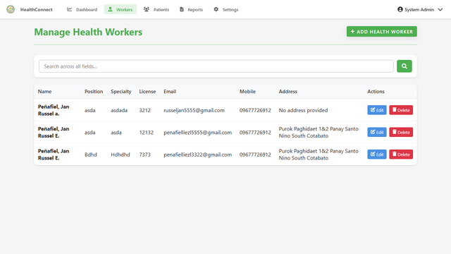
ADMIN PAGE;

Slide 73
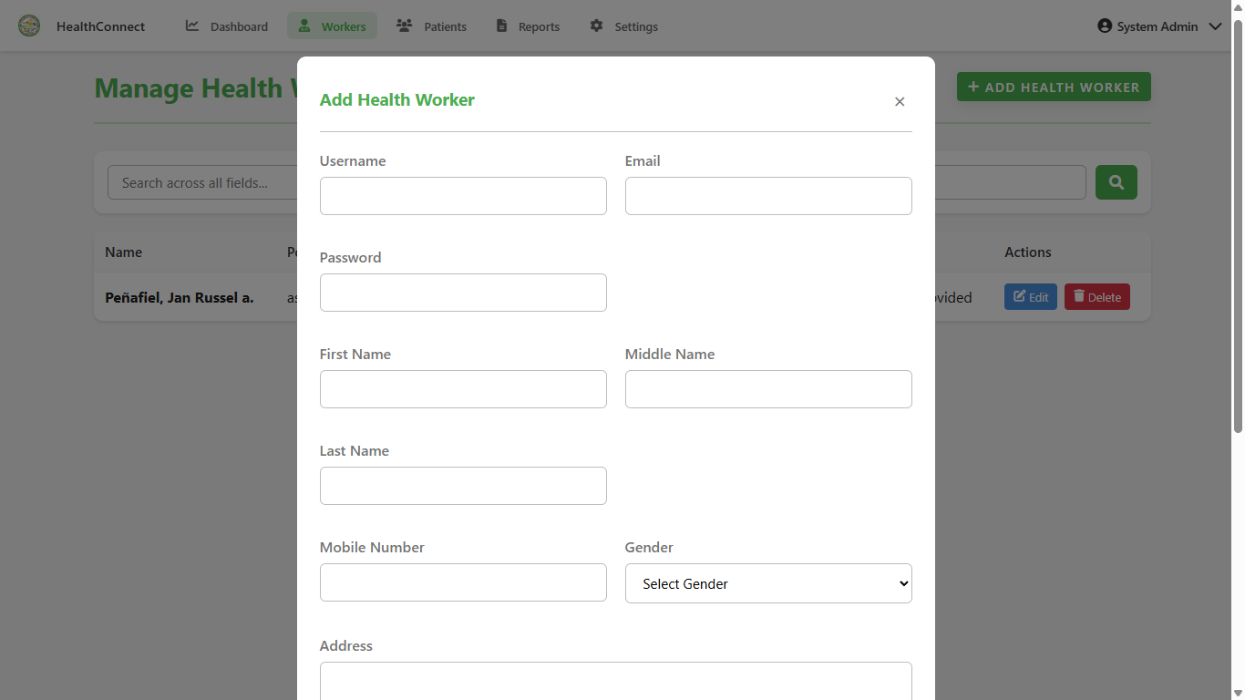
ADMIN PAGE;

Slide 74
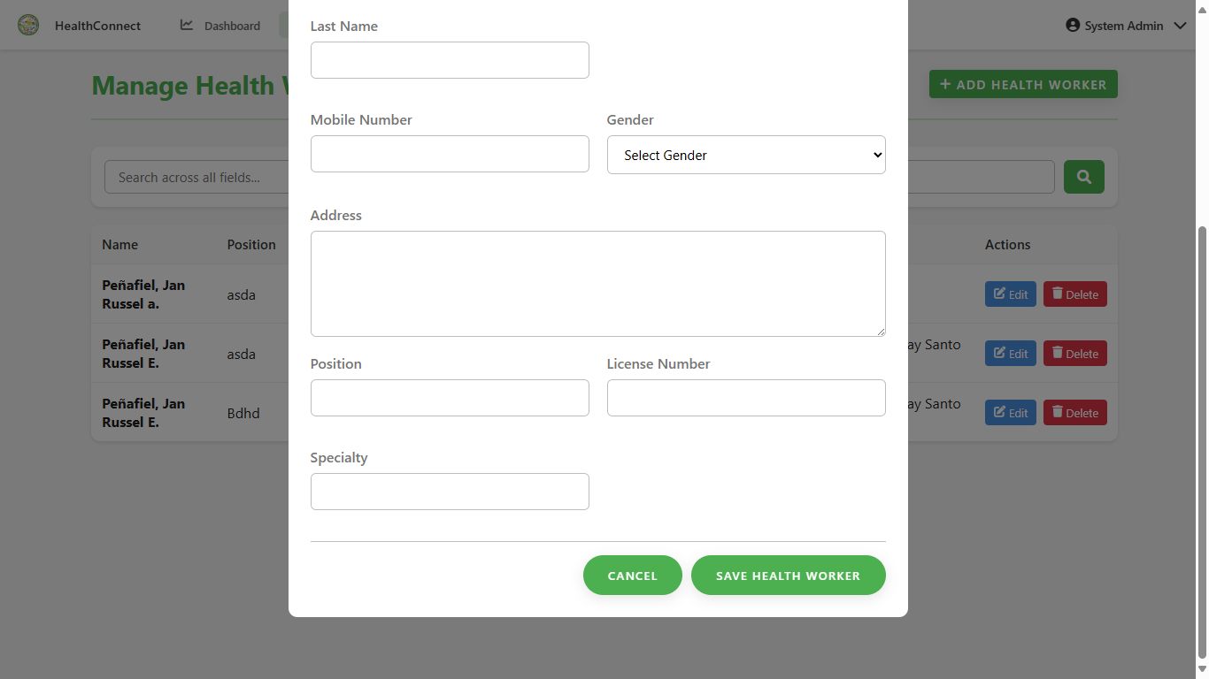
ADMIN PAGE;

Slide 75
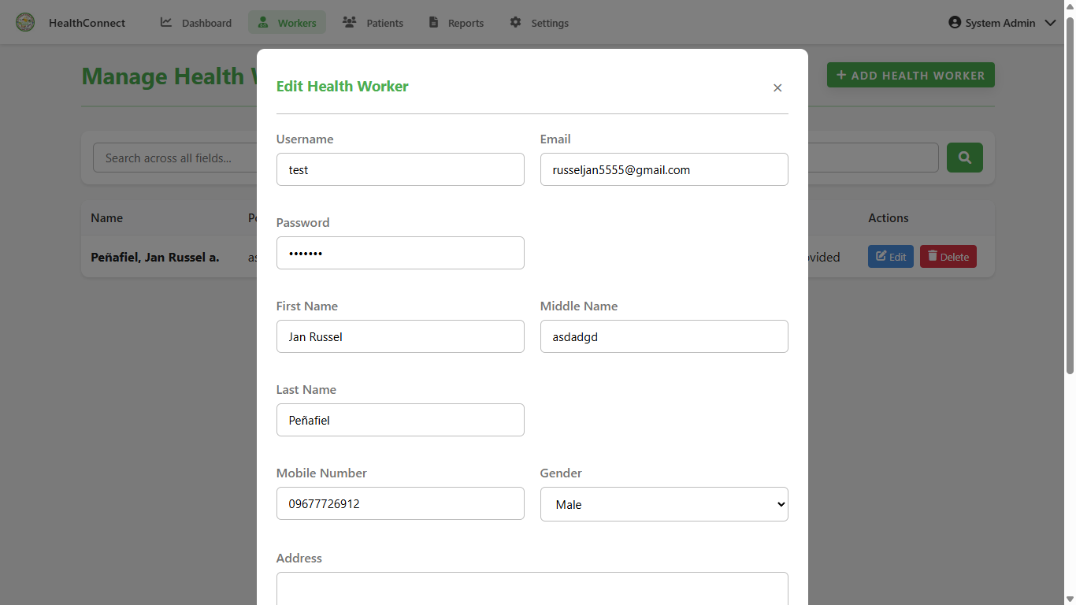
ADMIN PAGE;

Slide 76
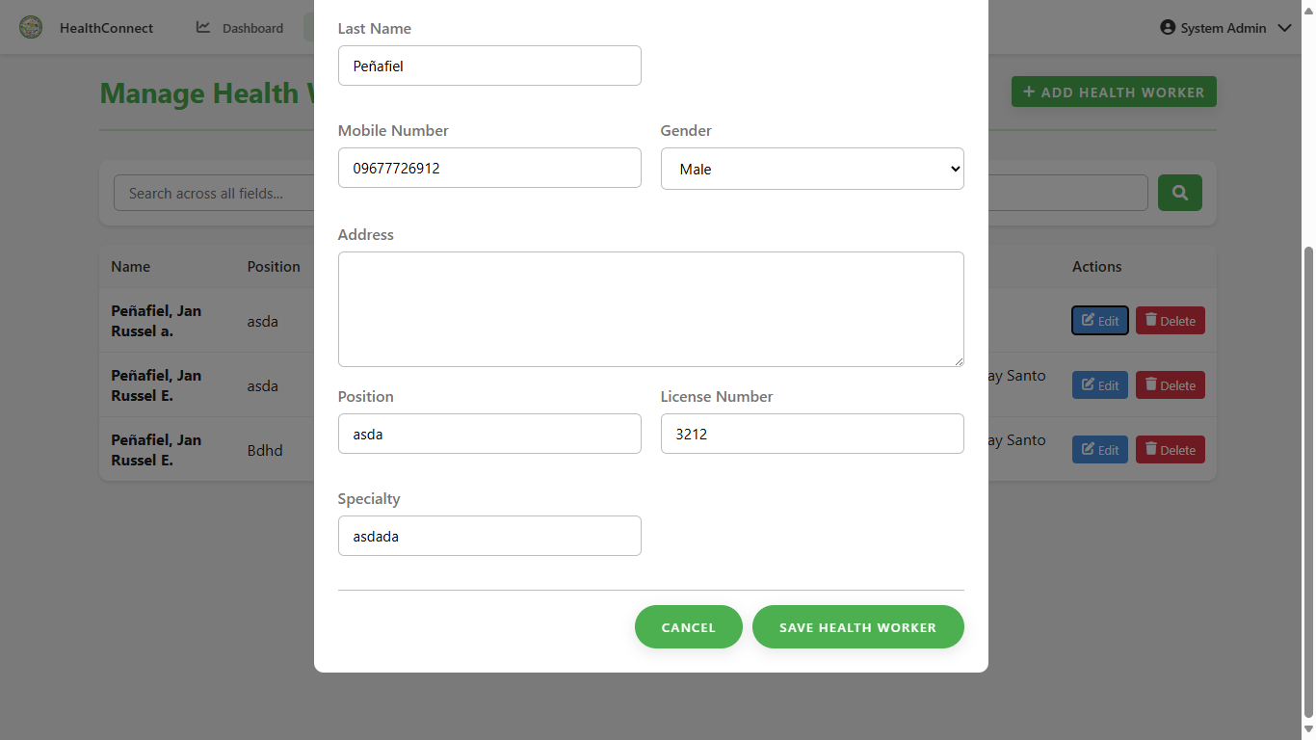
ADMIN PAGE;

Slide 77
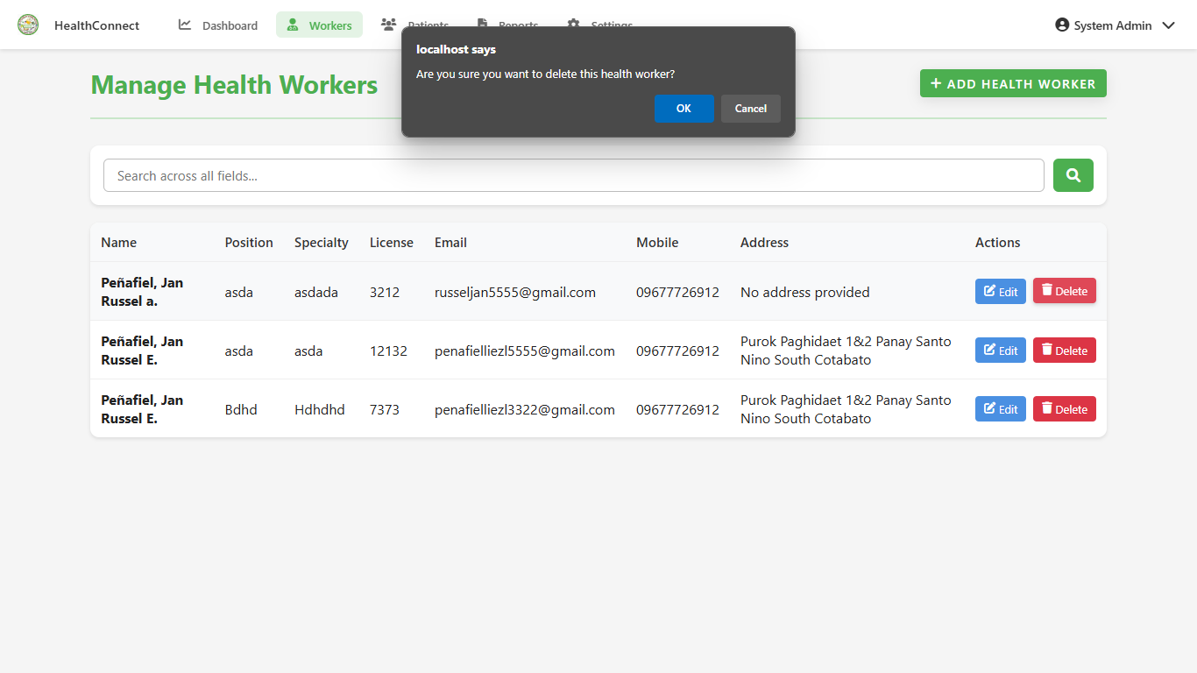
ADMIN PAGE;

Slide 78
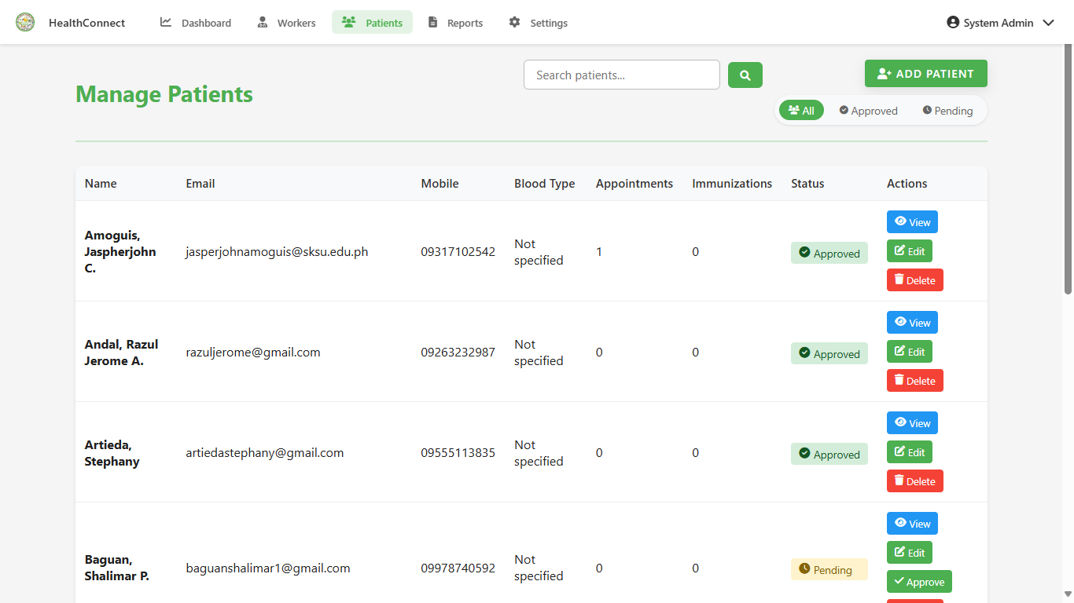
ADMIN PAGE;

Slide 79
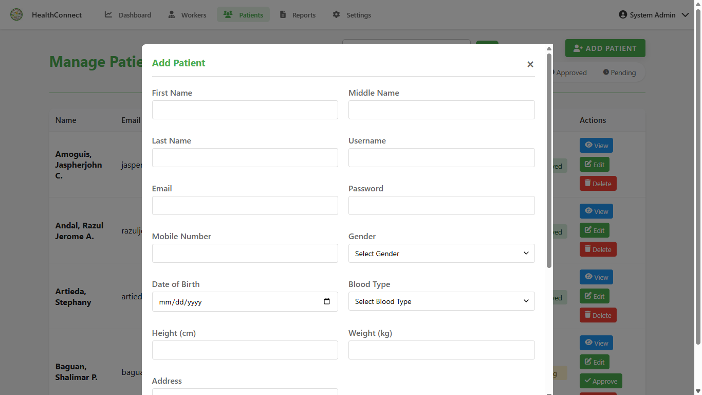
ADMIN PAGE;

Slide 80
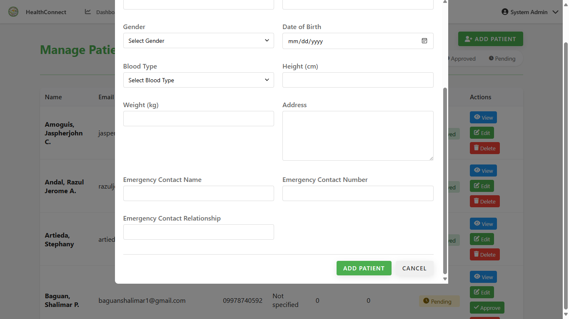
ADMIN PAGE;

Slide 81
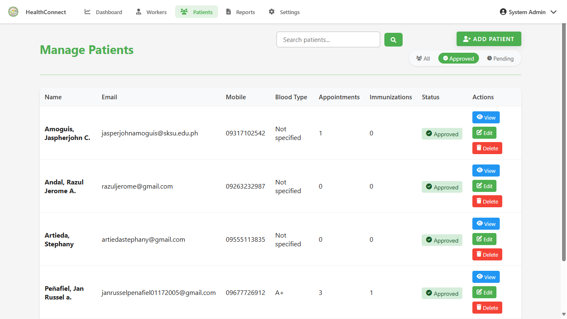
ADMIN PAGE;

Slide 82
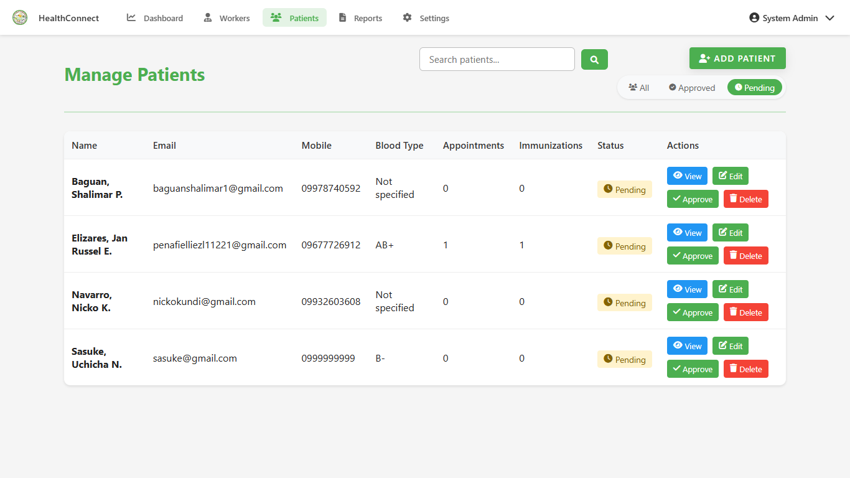
ADMIN PAGE;

Slide 83
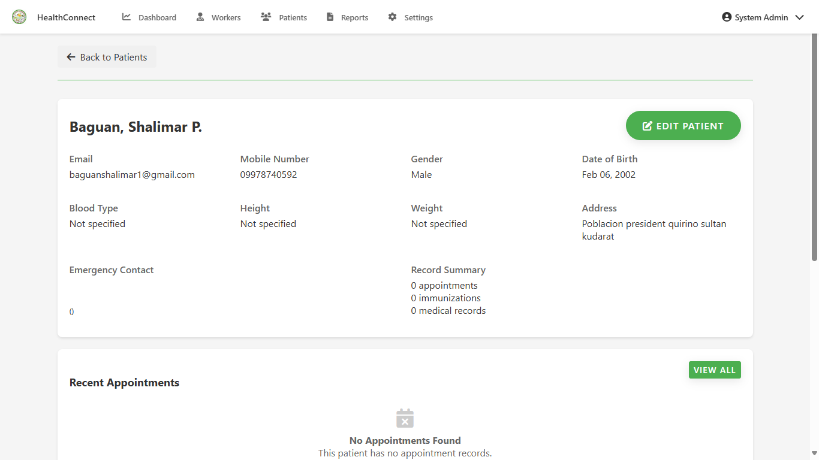
ADMIN PAGE;

Slide 84
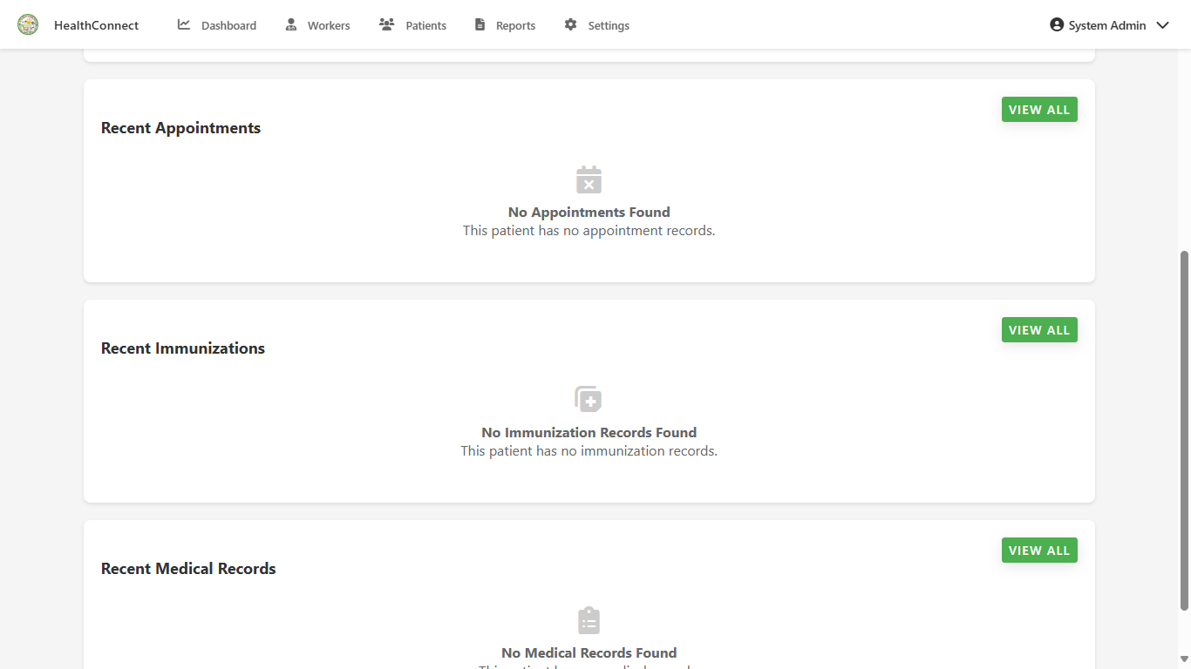
ADMIN PAGE;

Slide 85
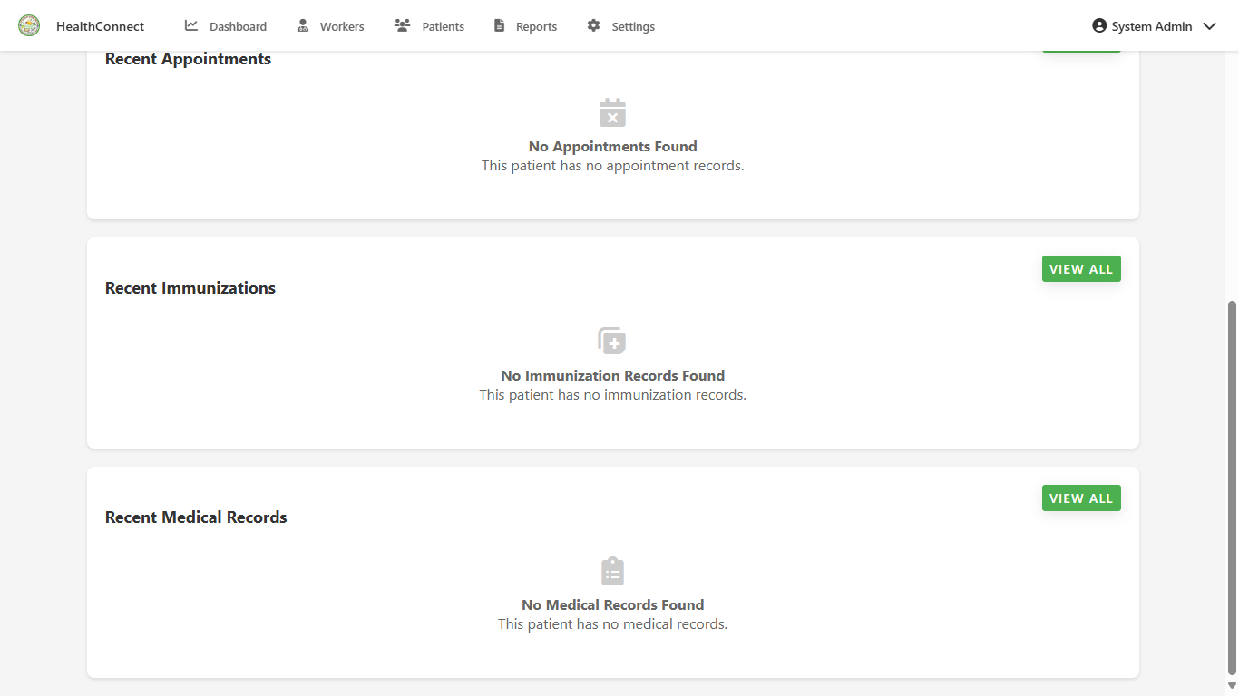
ADMIN PAGE;

Slide 86
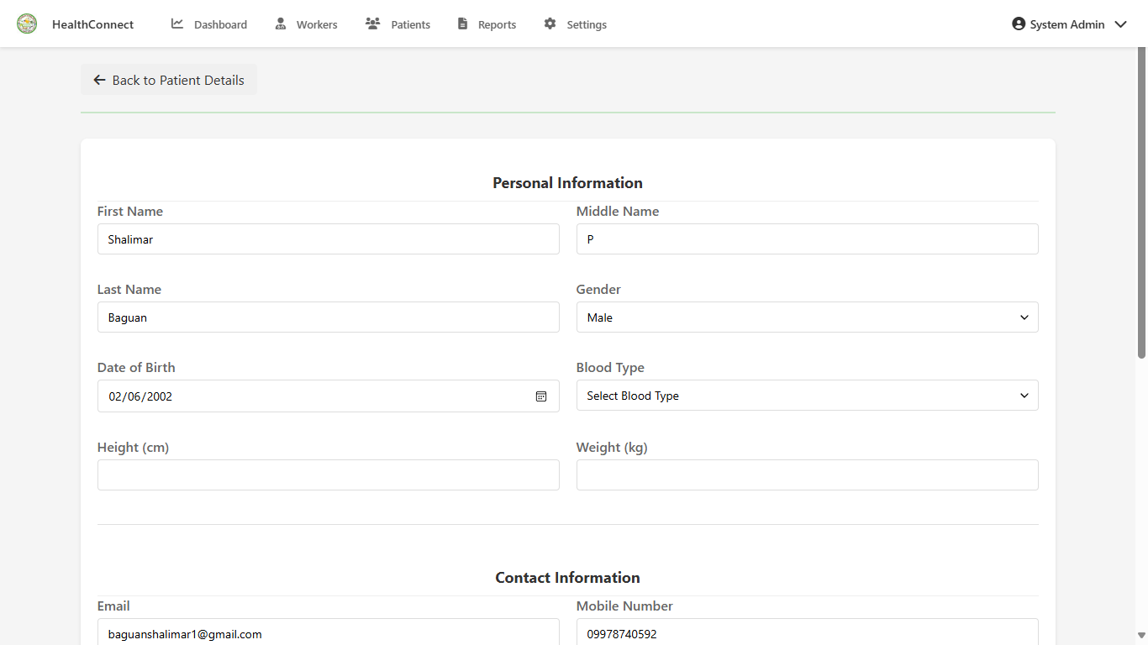
ADMIN PAGE;

Slide 87
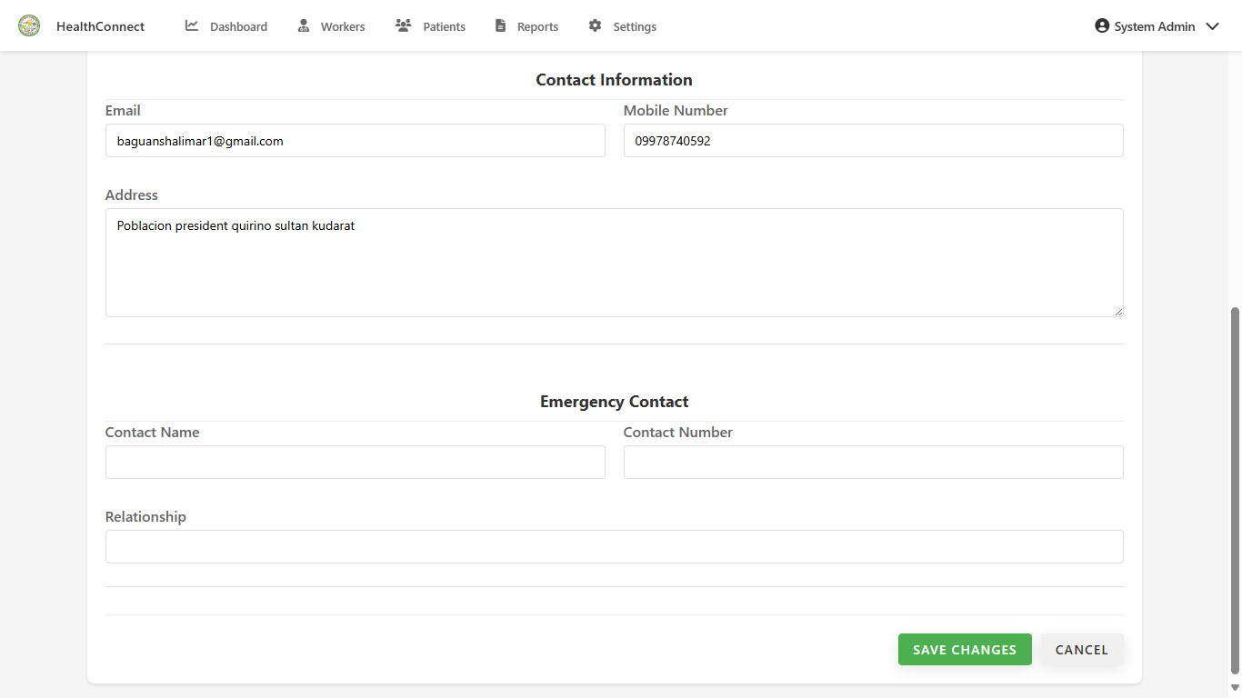
ADMIN PAGE;

Slide 88
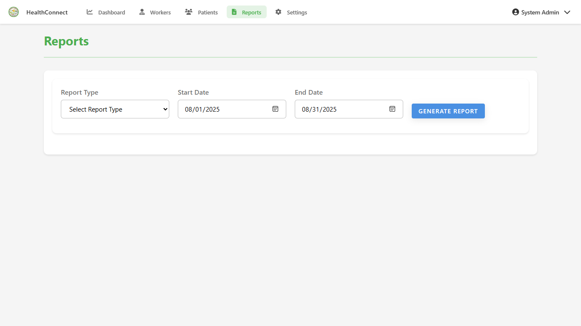
ADMIN PAGE;

Slide 89
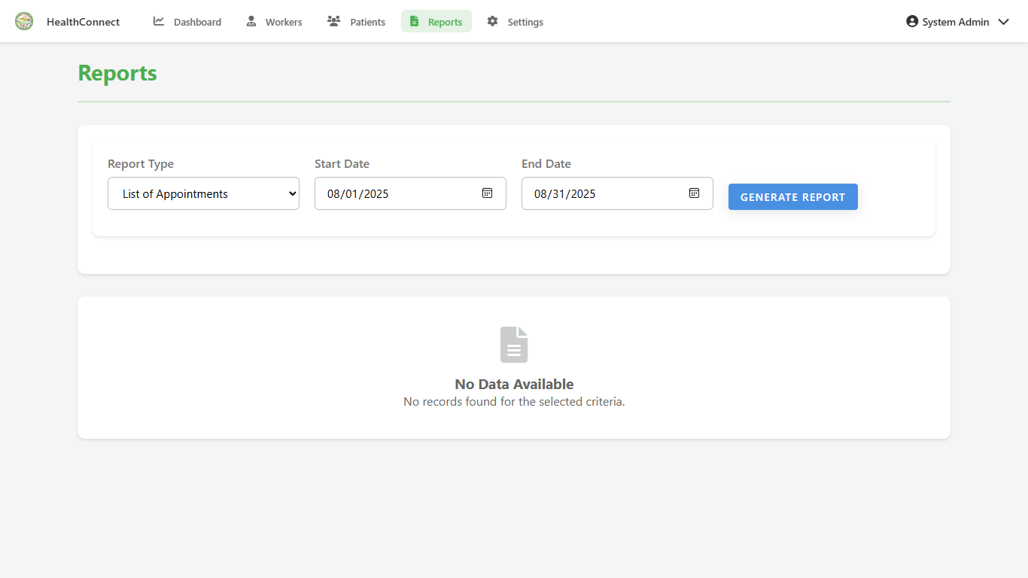
ADMIN PAGE;

Slide 90
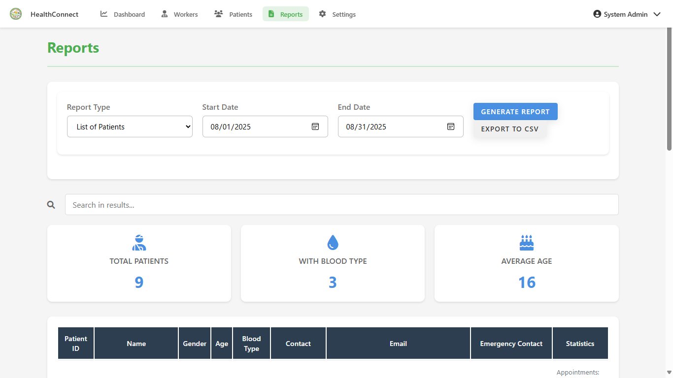
ADMIN PAGE;

Slide 91

ADMIN PAGE;

Slide 92

ADMIN PAGE;

Slide 93

ADMIN PAGE;

Slide 94

ADMIN PAGE;

Slide 95

ADMIN PAGE;

Slide 96

ADMIN PAGE;

Slide 97

ADMIN PAGE;

Slide 98

ADMIN PAGE;

Slide 99

ADMIN PAGE;

Slide 100

ADMIN PAGE;

Slide 101

ADMIN PAGE;

Slide 102
12
HEALTH WORKER PAGE

Slide 103

HEALTH WORKER PAGE;

Slide 104

HEALTH WORKER PAGE;

Slide 105

HEALTH WORKER PAGE;

Slide 106

HEALTH WORKER PAGE;

Slide 107

HEALTH WORKER PAGE;

Slide 108

HEALTH WORKER PAGE;

Slide 109

HEALTH WORKER PAGE;

Slide 110

HEALTH WORKER PAGE;

Slide 111

HEALTH WORKER PAGE;

Slide 112

HEALTH WORKER PAGE;

Slide 113

HEALTH WORKER PAGE;

Slide 114

HEALTH WORKER PAGE;

Slide 115

HEALTH WORKER PAGE;

Slide 116

HEALTH WORKER PAGE;

Slide 117

HEALTH WORKER PAGE;

Slide 118

HEALTH WORKER PAGE;

Slide 119

HEALTH WORKER PAGE;

Slide 120

HEALTH WORKER PAGE;

Slide 121

HEALTH WORKER PAGE;

Slide 122

HEALTH WORKER PAGE;

Slide 123

HEALTH WORKER PAGE;

Slide 124

HEALTH WORKER PAGE;

Slide 125
13
PATIENT PAGE

Slide 126

PATIENT PAGE;

Slide 127

PATIENT PAGE;

Slide 128

PATIENT PAGE;

Slide 129

PATIENT PAGE;

Slide 130

PATIENT PAGE;

Slide 131

PATIENT PAGE;

Slide 132

PATIENT PAGE;

Slide 133

PATIENT PAGE;

Slide 134

PATIENT PAGE;

Slide 135

PATIENT PAGE;

Slide 136

PATIENT PAGE;

Slide 137

PATIENT PAGE;

